Slide 1


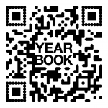
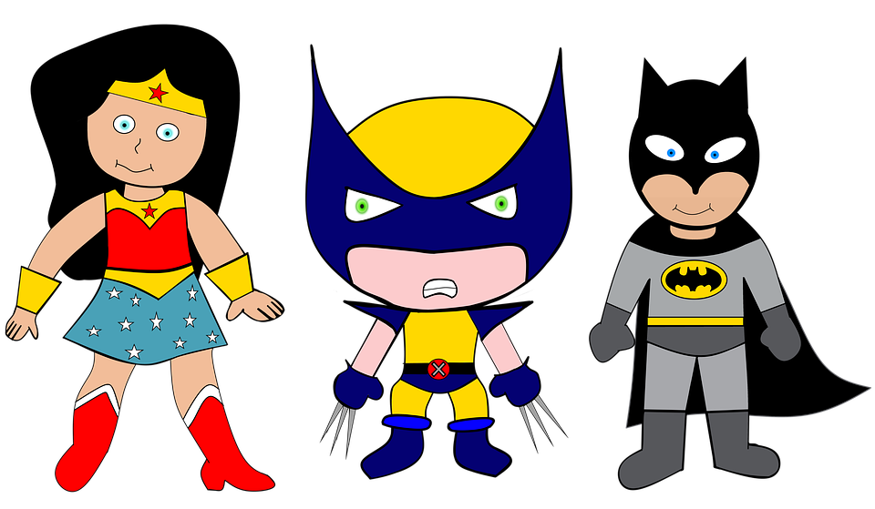

We are SUPERheroes!
Students Using their Powers to Engage in Reading!
Kindergarten Newsletter – February 21-25, 2022
IMPORTANT EVENTS
Breakfast ends at 7:25!
2-21 | No school
The EXPERT in anything was once a BEGINNER!
HOMEWORK
Mon. – Thurs. | Weekly ELA Sheet Math HW Pages Practice Sight Words List Read 10 minutes per night
WEEKLY ASSESSMENTS
ELA | Module 6.3 Listening test Oral Reading Fluency test
Math
SCHOOL NEWS
Don’t forget you can order yearbooks online. Our new Phonics program starts promptly at 7:45 a.m. everyday, so be sure your child is here before 7:30 a.m. We don’t want them to miss a minute of learning!
WEEKLY MATH SKILLS
Unknown number Writing 1,2,3,4,5,6,7,8,9,10 More and Less Decompose numbers 3-10 Adding/subtracting to 10
REMINDERS
Please make sure all money is sent in your child’s blue folder labeled and sealed. If your child is absent, please send an excuse labeled with the following information: Child’s name, date of absence, teacher’s name, and reason for absence.
SCHOOL SAFETY
Be sure your child wears a mask to school DAILY!

Slide 2
Module 6 Week 3: Home of the Free and the Brave
LEARNING MINDSET: Asking for Help
ESSENTIAL QUESTION
What makes the USA special?
PHONICS
Introduce : S blends & L blends - ake word family
READING
Genre: Fiction Story Elements: Characters, Settings, Events Informational Texts | Listening Comprehension Parts of a Book Collaborative discussions
WORDS TO KNOW
As Our Red that
VOCABULARY
BIG IDEA WORDS: Belong, Country, Right POWER WORDS: believe, law, refuse Books: Martin Luther King Jr. and President’s Day
REVIEW
Letters and sounds Aa-Ff Gg-Pp Qq-Zz
WRITING
Nouns and Verbs Characters/Setting Narratives
SPELLING WORDS
No spelling test this week
PHONEMIC AWARENESS
Identify Rhymes Identify Syllables Beg., Medial, Final Sounds

